Slide 1

Chapter 6
Photodetectors

Slide 2
Content
Physical Principles of Photodiodes
pin, APD
Photodetectors characteristics (Quantum efficiency, Responsivity, S/N)
Noise in Photodetector Circuits
Photodiode Response Time
Photodiodes structures

Slide 3
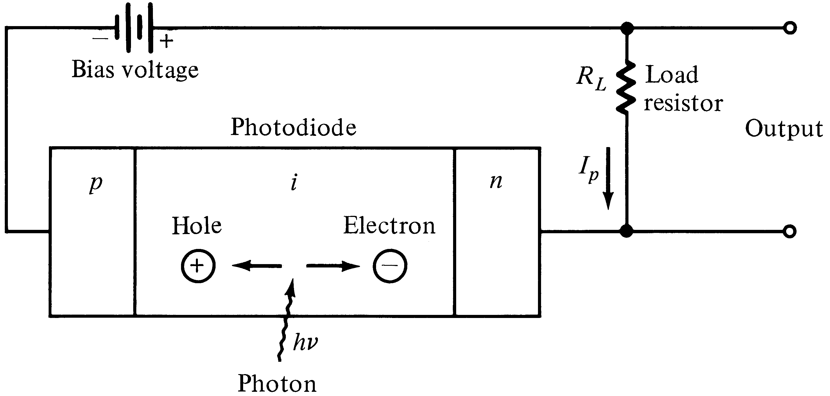
pin Photodetector
w
The high electric field present in the depletion region causes photo-generated carriers to
Separate and be collected across the reverse –biased junction. This give rise to a current
Flow in an external circuit, known as photocurrent.

Slide 4
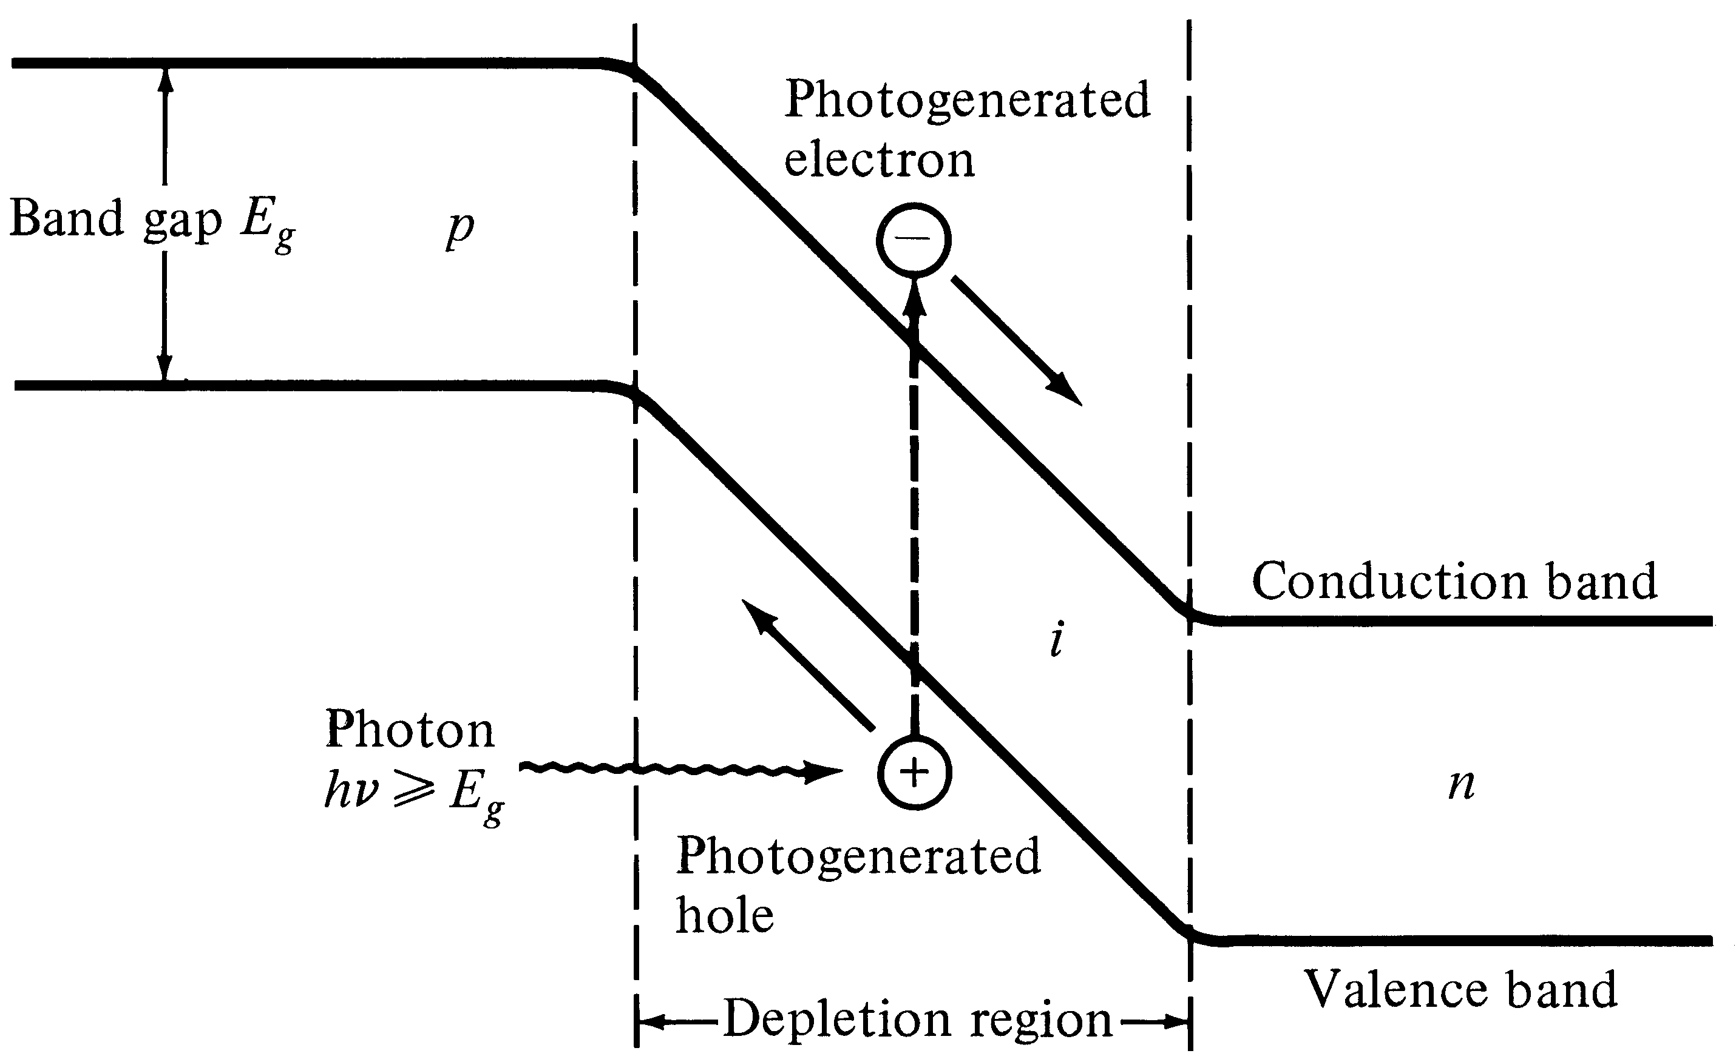
Energy-Band diagram for a pin photodiode

Slide 5


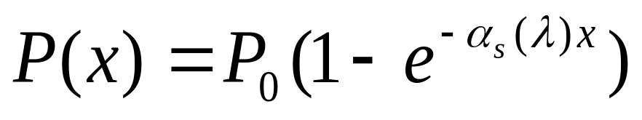

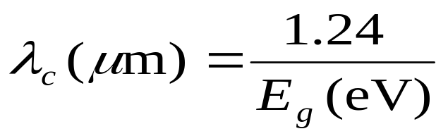

Photocurrent
Optical power absorbed, in the depletion region can be written in terms of incident optical power, :
Absorption coefficient strongly depends on wavelength. The upper wavelength cutoff for any semiconductor can be determined by its energy gap as follows:
Taking entrance face reflectivity into consideration, the absorbed power in the width of depletion region, w, becomes:
[6-1]
[6-2]

Slide 6
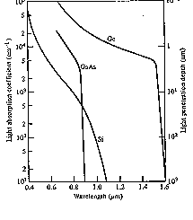
Optical Absorption Coefficient

Slide 7
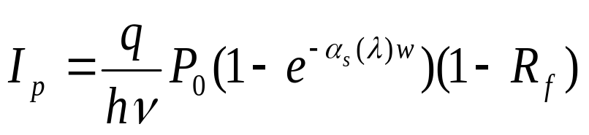
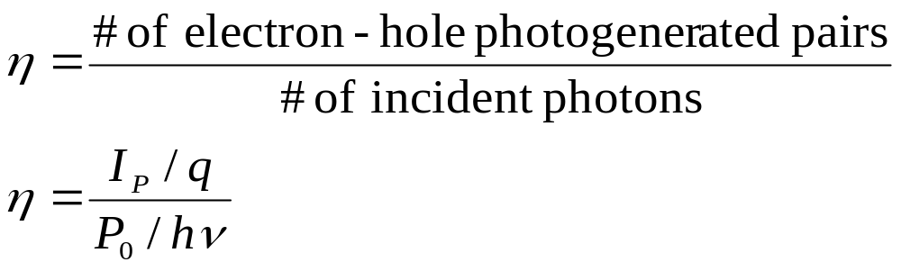
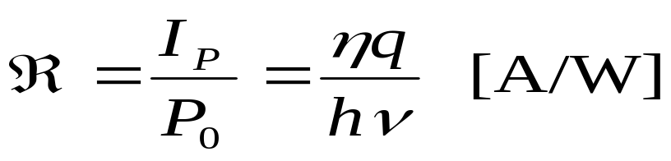
Responsivity
The primary photocurrent resulting from absorption is:
Quantum Efficiency:
Responsivity:
[6-3]
[6-4]
[6-5]

Slide 8
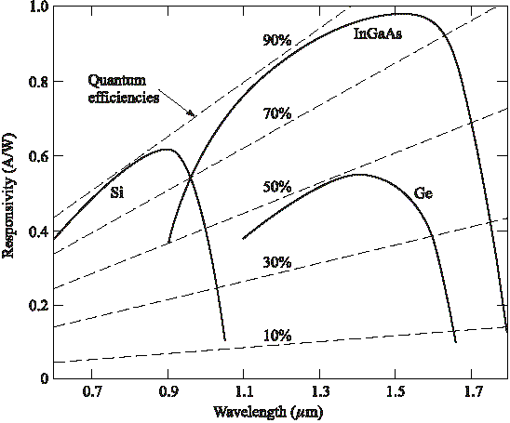
Responsivity vs. wavelength

Slide 9
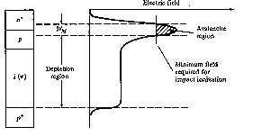
Avalanche Photodiode (APD)
APDs internally multiply the primary photocurrent before it enters to following circuitry.
In order to carrier multiplication take place, the photogenerated carriers must traverse along a high field region. In this region, photogenerated electrons and holes gain enough energy to ionize bound electrons in VB upon colliding with them. This multiplication is known as impact ionization. The newly created carriers in the presence of high electric field result in more ionization called avalanche effect.
Optical radiation
Reach-Through APD structure (RAPD)
showing the electric fields in depletion region and multiplication region.

Slide 10
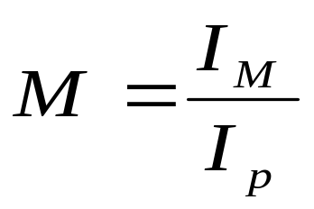


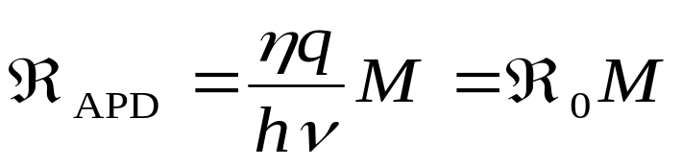
Responsivity of APD
The multiplication factor (current gain) M for all carriers generated in the photodiode is defined as:
Where is the average value of the total multiplied output current & is the primary photocurrent.
The responsivity of APD can be calculated by considering the current gain as:
[6-6]
[6-7]

Slide 11
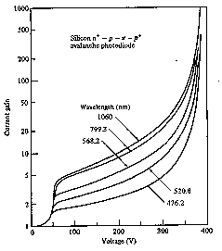
Current gain (M) vs. Voltage for different optical wavelengths

Slide 12
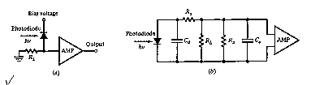
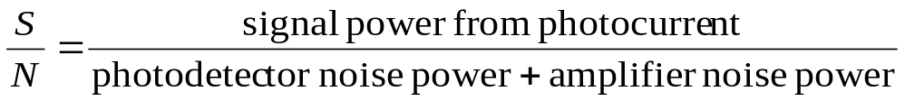
Photodetector Noise & S/N
Detection of weak optical signal requires that the photodetector and its following amplification circuitry be optimized for a desired signal-to-noise ratio.
It is the noise current which determines the minimum optical power level that can be detected. This minimum detectable optical power defines the sensitivity of photodetector. That is the optical power that generates a photocurrent with the amplitude equal to that of the total noise current (S/N=1)

Slide 13
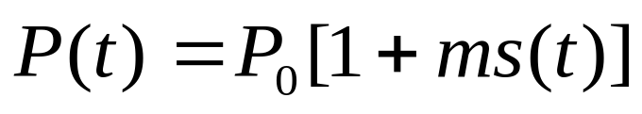
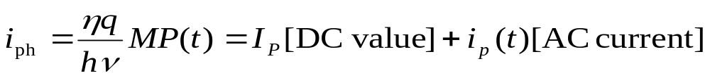
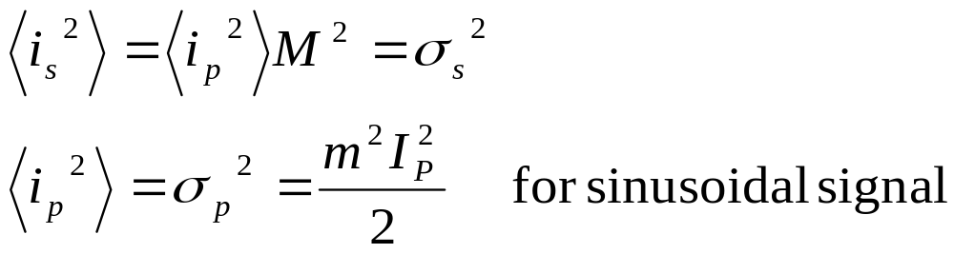
Signal Calculation
Consider the modulated optical power signal P(t) falls on the photodetector with the form of:
Where s(t) is message electrical signal and m is modulation index. Therefore the primary photocurrent is (for pin photodiode M=1):
The root mean square signal current is then:
[6-8]
[6-9]
[6-9]
[6-10]

Slide 14
Noise Sources in Photodetecors
The principal noises associated with photodetectors are :
1- Quantum (Shot) noise: arises from statistical nature of the production and collection of photo-generated electrons upon optical illumination. It has been shown that the statistics follow a Poisson process.
2- Dark current noise: is the current that continues to flow through the bias circuit in the absence of the light. This is the combination of bulk dark current, which is due to thermally generated e and h in the pn junction, and the surface dark current, due to surface defects, bias voltage and surface area.
In order to calculate the total noise presented in photodetector, we should sum up the root mean square of each noise current by assuming that those are uncorrelated.
Total photodetector noise current=quantum noise current +bulk dark current noise + surface current noise

Slide 15
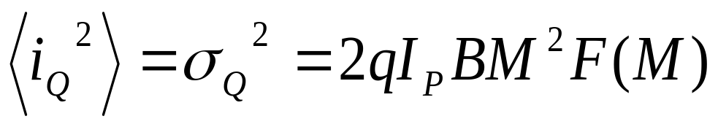

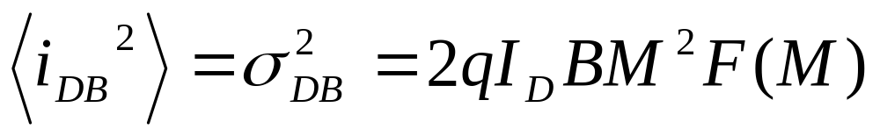

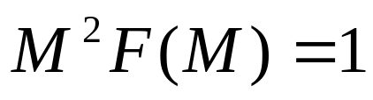

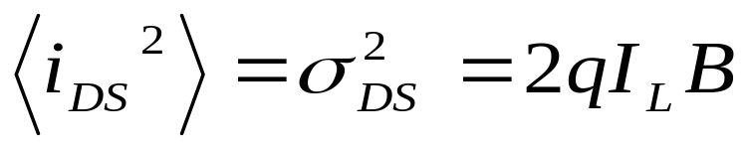
Noise calculation (1)
Quantum noise current (lower limit on the sensitivity):
B: Bandwidth, F(M) is the noise figure and generally is
Bulk dark current noise:
is bulk dark current
Surface dark current noise: is the surface current.
[6-11]
[6-12]
Note that for pin photodiode
[6-13]

Slide 16
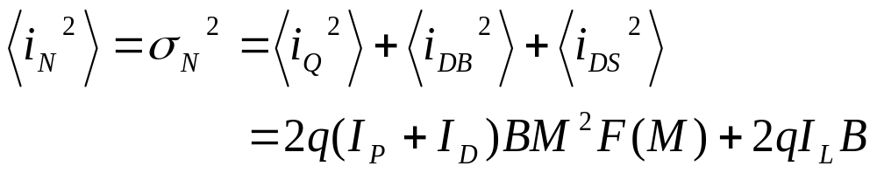
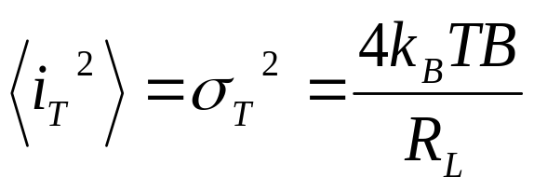


Noise calculation (2)
The total rms photodetector noise current is:
The thermal noise of amplifier connected to the photodetector is:
input resistance of amplifier, and is Boltzmann cte.
[6-14]
[6-15]

Slide 17
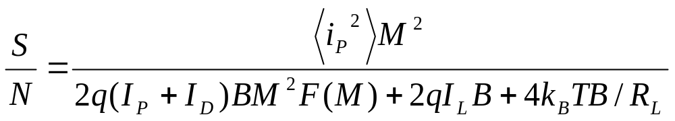

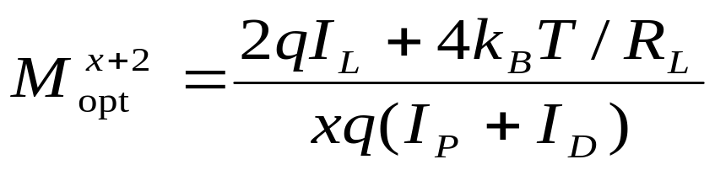
S/N Calculation
Having obtained the signal and total noise, the signal-to-noise-ratio can be written as:
Since the noise figure F(M) increases with M, there always exists an optimum value of M that maximizes the S/N. For sinusoidally modulated signal with m=1 and :
[6-16]
[6-17]

Slide 18

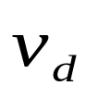
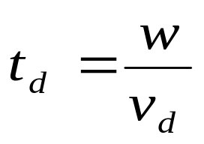
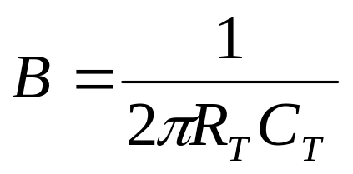

Photodetector Response Time
The response time of a photodetector with its output circuit depends mainly on the following three factors:
1- The transit time of the photocarriers in the depletion region. The transit time depends on the carrier drift velocity and the depletion layer width w, and is given by:
2- Diffusion time of photocarriers outside depletion region.
3- RC time constant of the circuit. The circuit after the photodetector acts like RC low pass filter with a passband given by:
[6-18]
[6-19]

Slide 19
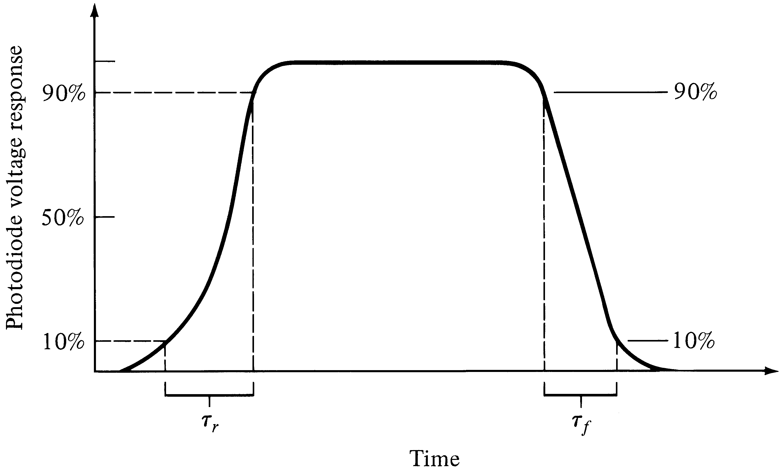
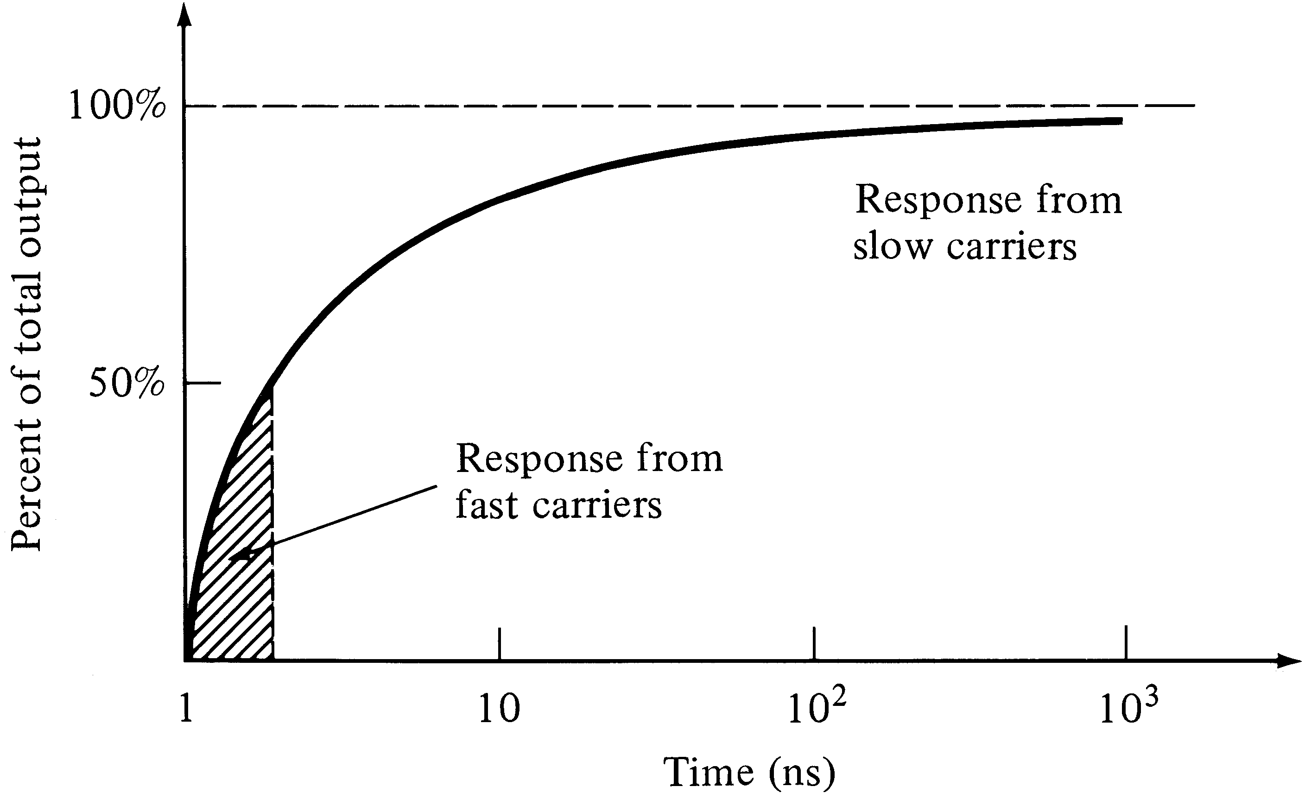
Photodiode response to optical pulse
Typical response time of the
photodiode that is not fully depleted

Slide 20
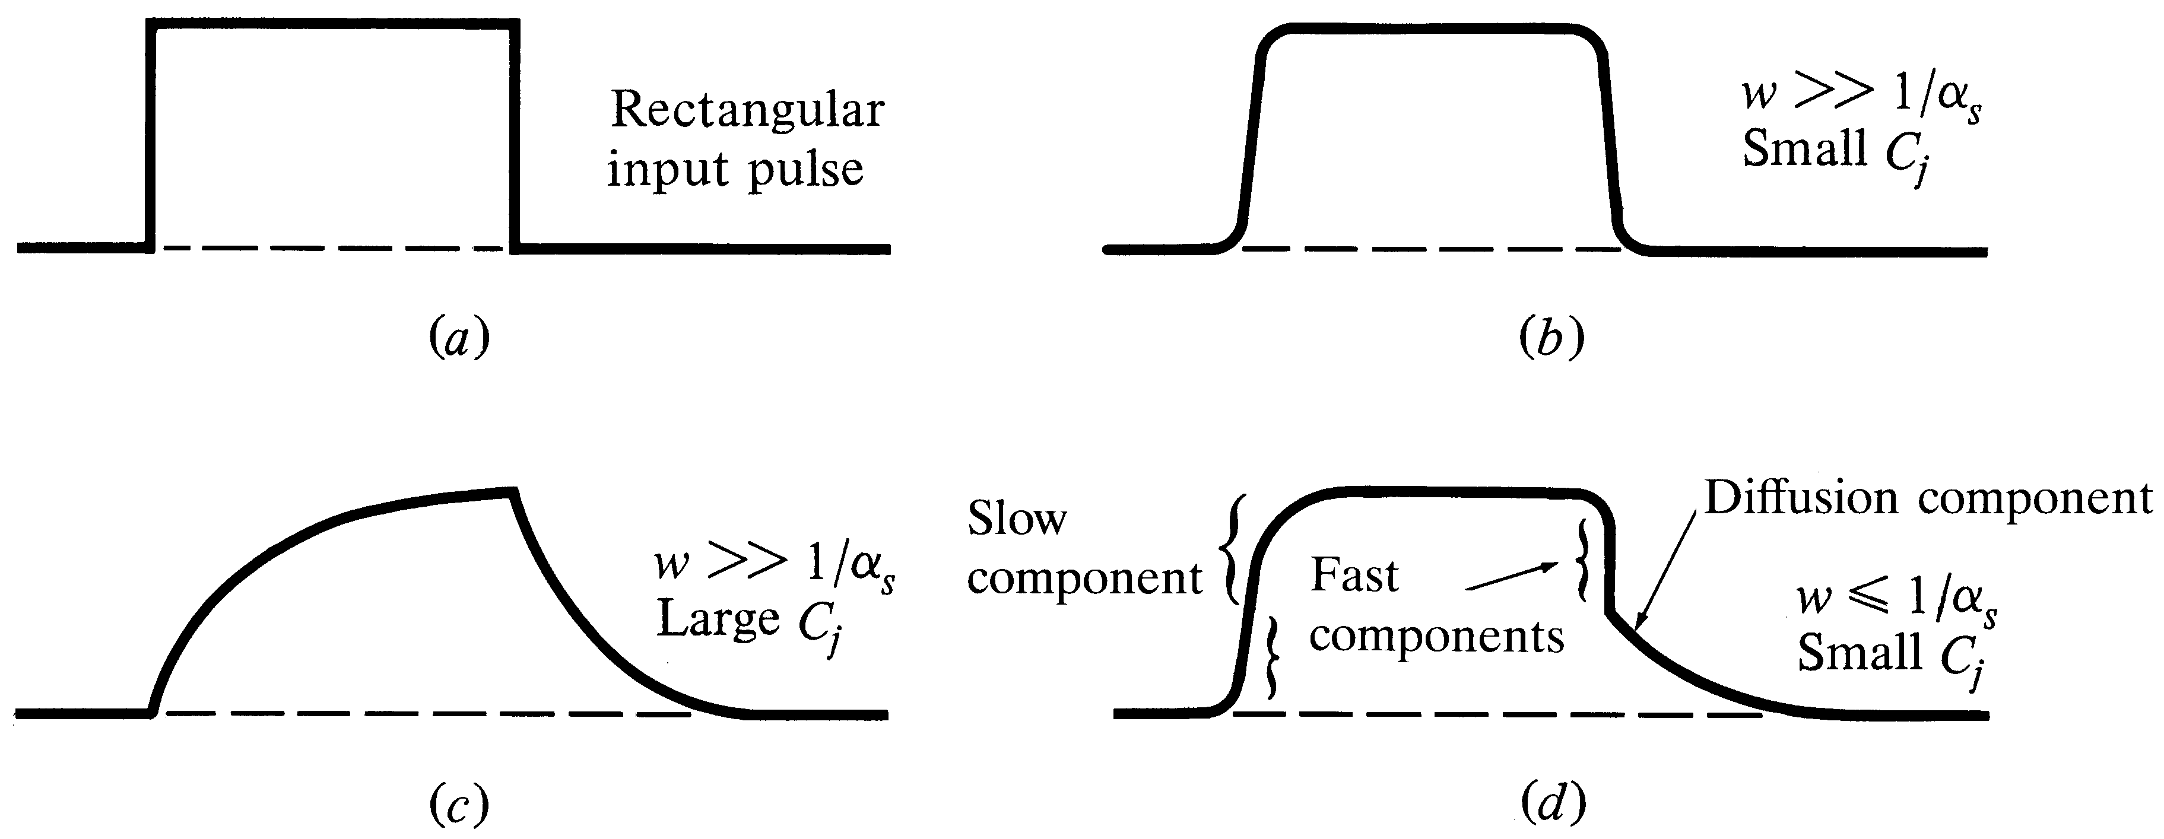

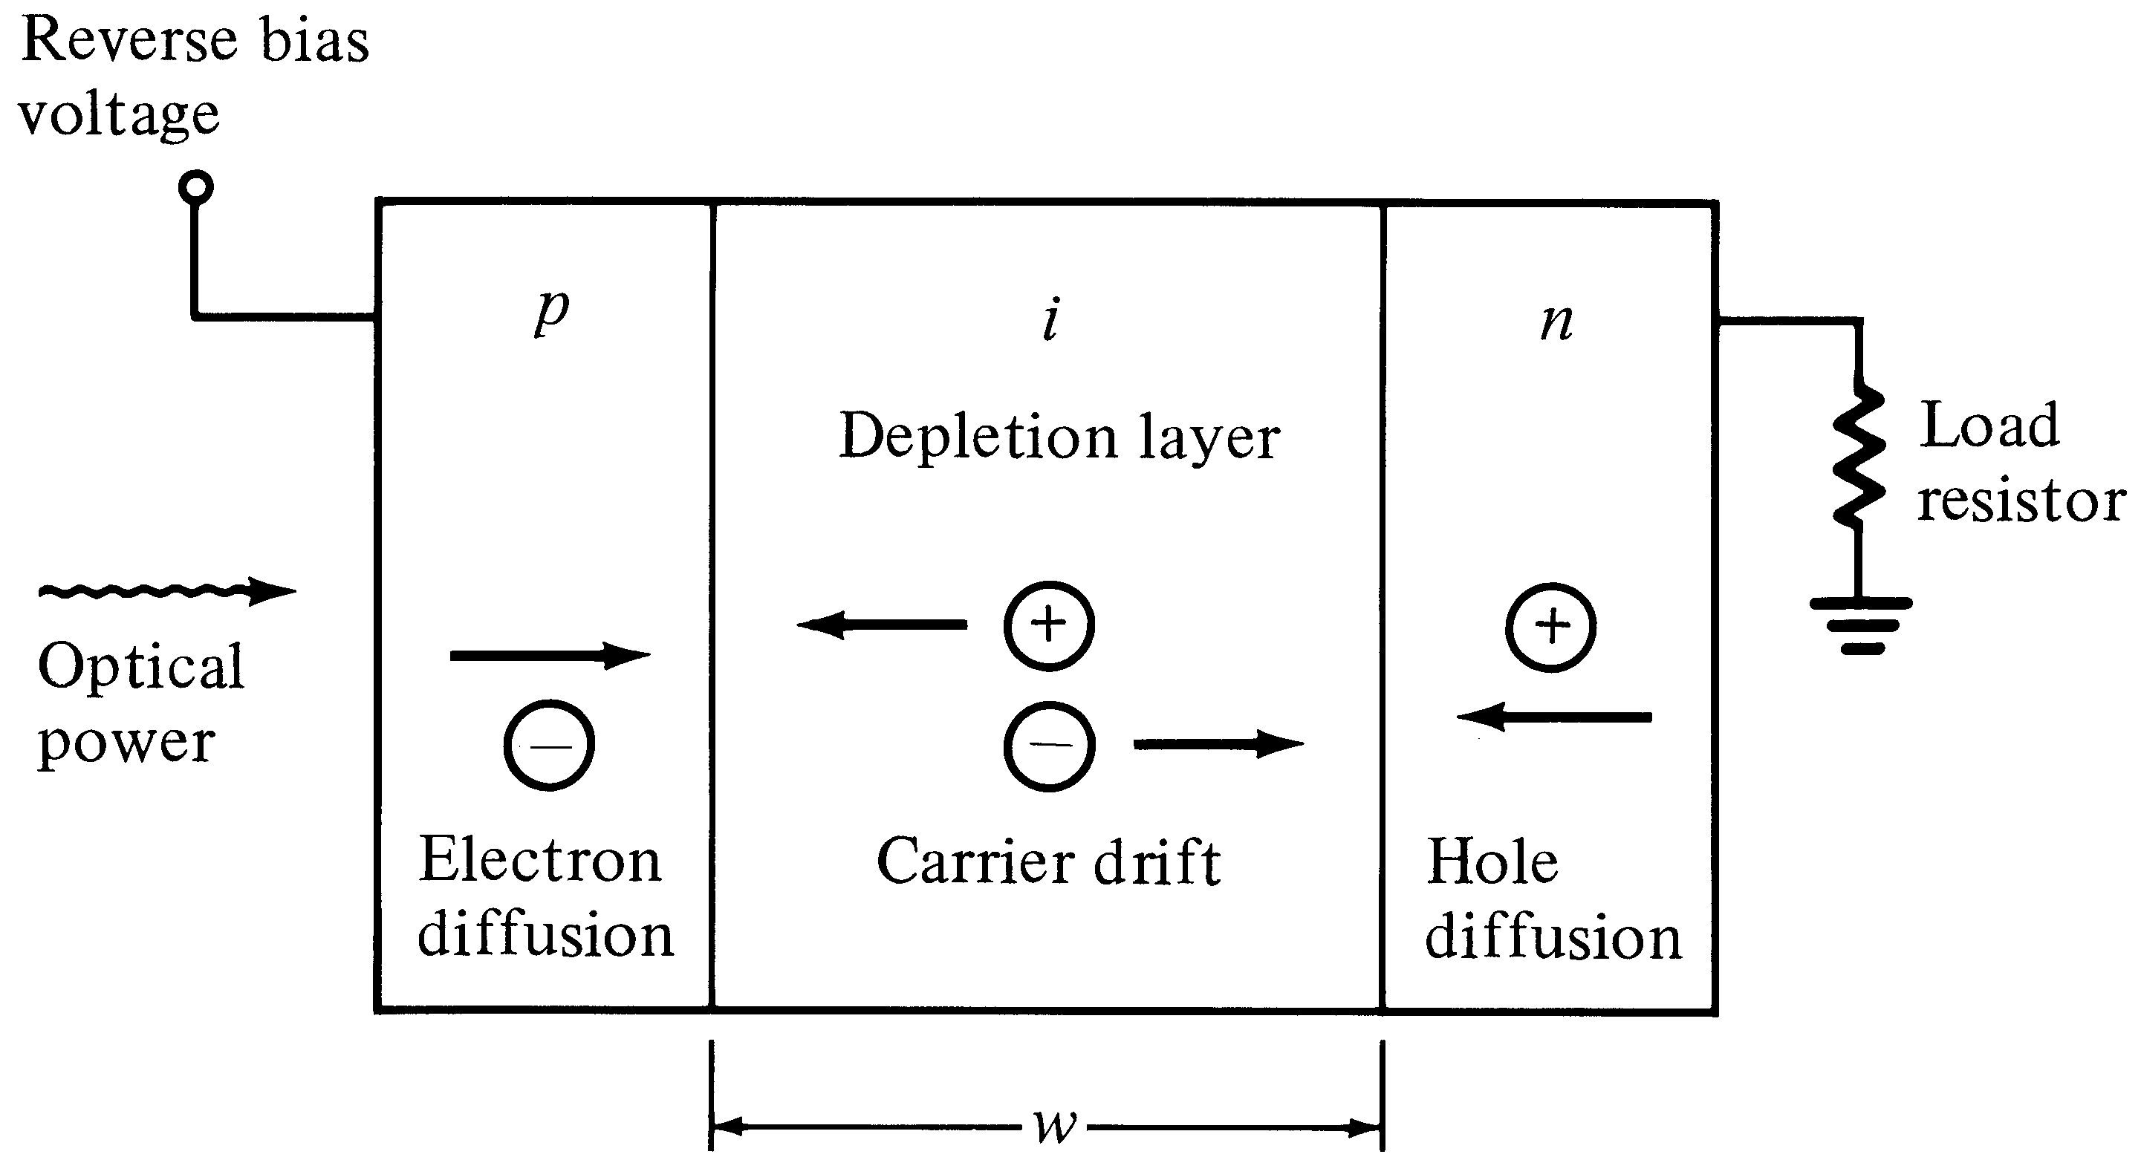

Various optical responses of photodetectors:
Trade-off between quantum efficiency & response time
To achieve a high quantum efficiency, the depletion layer width must be larger than
(the inverse of the absorption coefficient), so that most of the light will be absorbed. At the same time with large width, the capacitance is small and RC time constant getting smaller, leading to faster response, but wide width results in larger transit time in the depletion region. Therefore there is a trade-off between width and QE. It is shown that the best is:

Slide 21
Structures for InGaAs APDs
Separate-absorption-and multiplication (SAM) APD
InGaAs APD superlattice structure (The multiplication region is composed of several layers of InAlGaAs quantum wells separated by InAlAs barrier layers.
light
InP substrate
InP buffer layer
INGaAs Absorption layer
InP multiplication layer
Metal contact

Slide 22
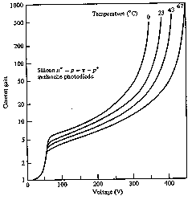
Temperature effect on avalanche gain

Slide 23
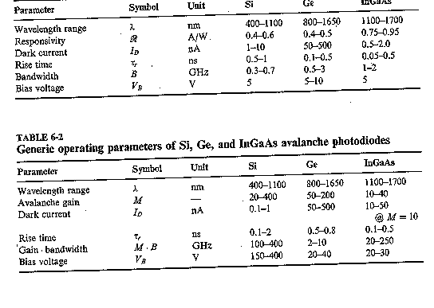
Comparison of photodetectors

